Slide 1
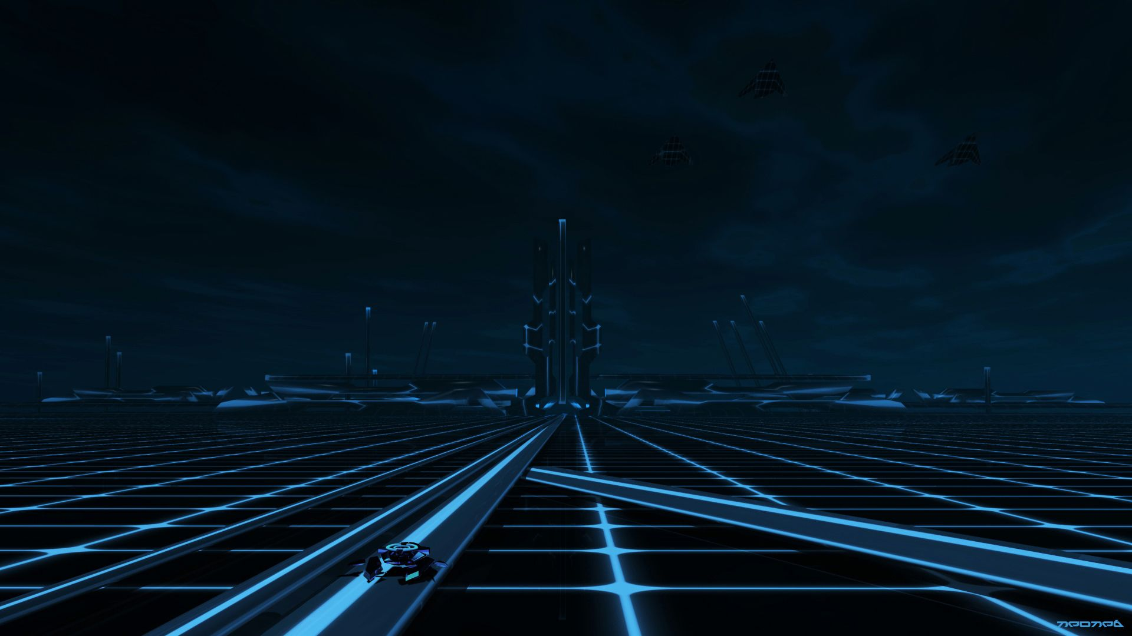


Project-1: Archery Game
CME1251 Project Based Learning
BY
2020510171 SUDE KÜNDÜROĞLU
2020510201 ZÜBEYDE ELİF ARAL
2021510119 EMRE KERMAN

Slide 2

TABLE OF CONTENTS
01
Progress Summary
02
Problems Encountered
03
Algorithms And Solution Strategies
04
Screenshots
05
Conclusion

Slide 3
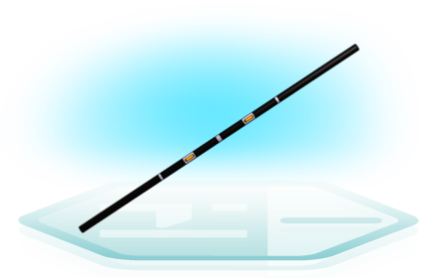
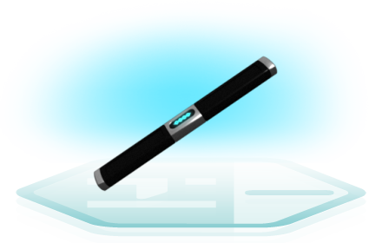

INTRODUCTION
The aim of this project is to develop a game with three opponent players. User and two other opponents take shots at each other with different types of guns.
The closer players going to attack.
The game area is -10 to 10 x and y axis coordinate plane.

Slide 4
01
Requirements
Task Sharing & Scheduling
Completed Tasks & Incomplete Tasks
Additional Improvements
PROGRESS SUMMARY

Slide 5

REQUIREMENTS
Getting coordinates from player.
Placing opponents (B and C) randomly.
Setting three sets and health randomly for those three opponents.
Showing player and other opponents in coordinate plane.
Finding minimum distance between three opponents.
Finding who wins while two opponents in fight.
Making two rounds then setting the winner of this game.

Slide 6
TASK SHARING & SCHEDULING
SUDE KÜNDÜROĞLU
EMRE KERMAN
ZÜBEYDE ELİF ARAL
+Helped while making flowchart.
+Wrote the main code
+Added color statements into code.
+Made last version of flowchart.
+Solved most of the problems and made algorithms for solving.
+Helped while writing code.
+Made first version of flowchart.
+Helped while writing code.
+Helped while solving problems.

Slide 7
SCHEDULING
WEEK 2
WEEK 3
We decided to divide first part of the code by three.
We code one by one and sum all of them.
We wrote a mid report.
We already made a main flowchart so we tried to wrote the code by ourselves.
We choose the best code in our codes.
WEEK 4
WEEK 1
We met with group members.
Planed what we are going to do, and we made a brainstorm.
We all made flowchart by ourselves and combined with each other.
We made powerpoint presentation and a game poster.
We wrote final report.

Slide 8
COMPLETED TASKS
INCOMPLETE TASKS
Getting coordinates from user
Showing coordinate table and on that table showing players
Assign set and health variables randomly to opponents.
Calculating distance, comparing assigned sets and calculating scores.
Showing rounds, scores and winners.
There is no incomplete tasks because we found a solution for all our problems, we add improvements to our code.

Slide 9
ADDITIONAL IMPROVEMENTS
Monkey Type
We add monkey typing in our code because we want to our code work correctly.
Console Colors
We add color to opponents by getting sets because we want to be colorful.
Theme
We add a theme and a little bit story to our game becasue we want to be more playable game.

Slide 10
02
Randomizing Sets And Health Statements
Printing The Coordinate Plane & Showing Players
PROBLEMS ENCOUNTERED

Slide 11
Randomizing Sets And Health Statements
Printing The Coordinate Plane & Showing Players
When we learned about, we
couldn’t use loop statements we
had to think about how to love
this problem.
First, we didn’t know how to show up coordinate plane and there was second problem, that was how to replace the players on the plane.

Slide 12
03
Algorithms And Solution Strategies
Flowchart
Solution Strategies

Slide 13
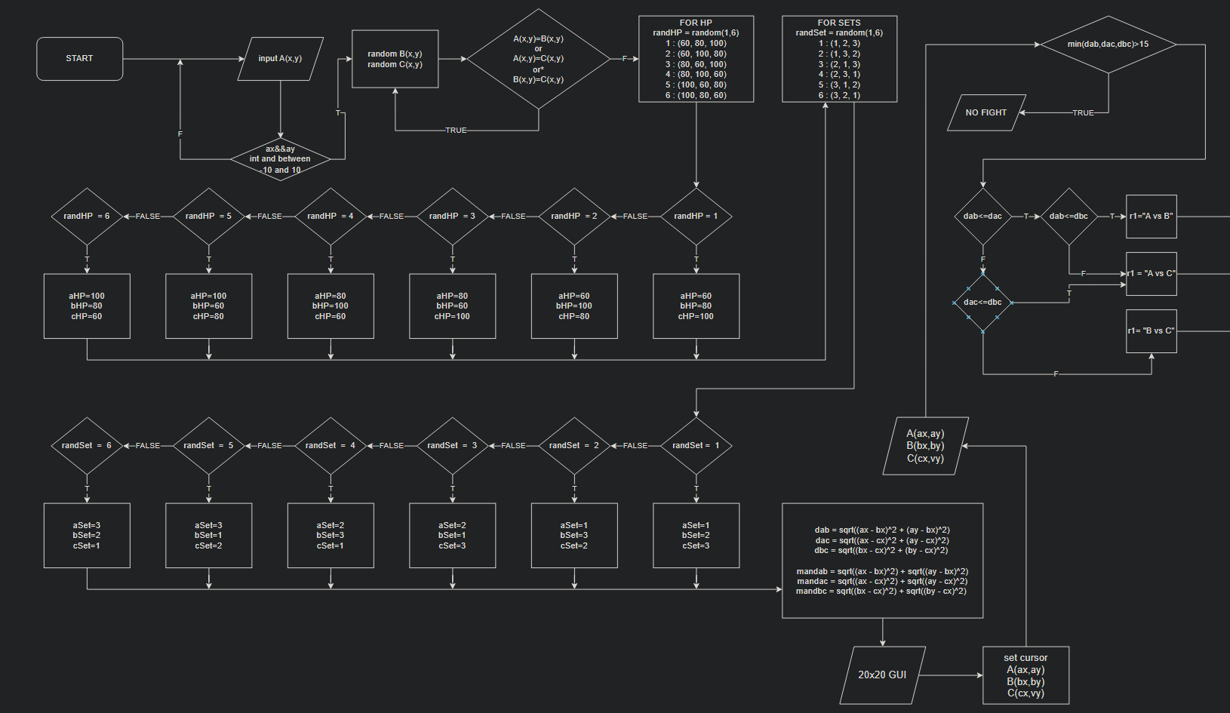
FIRST PART OF FLOWCHART

Slide 14
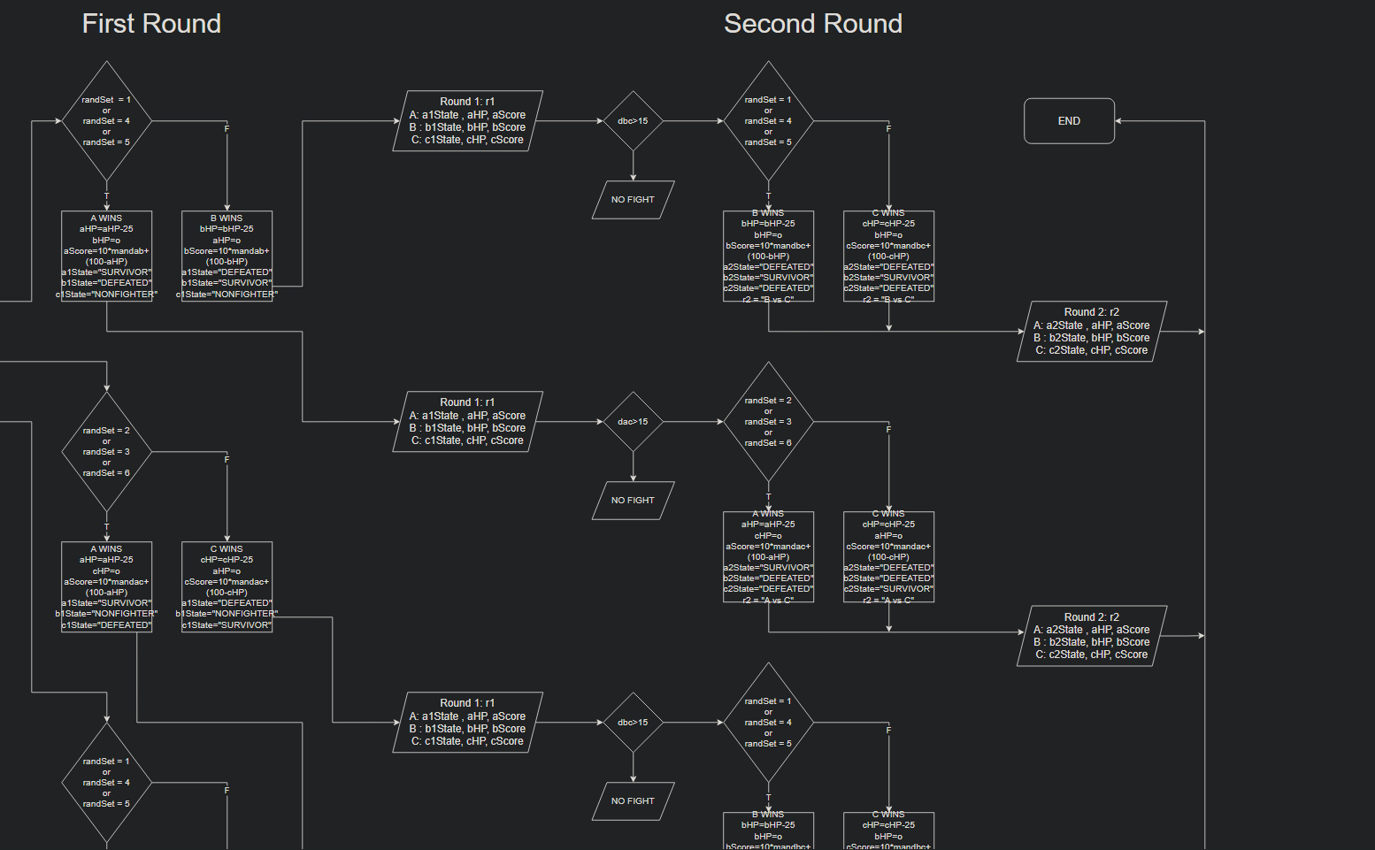
SECOND PART OF FLOWCHART

Slide 15
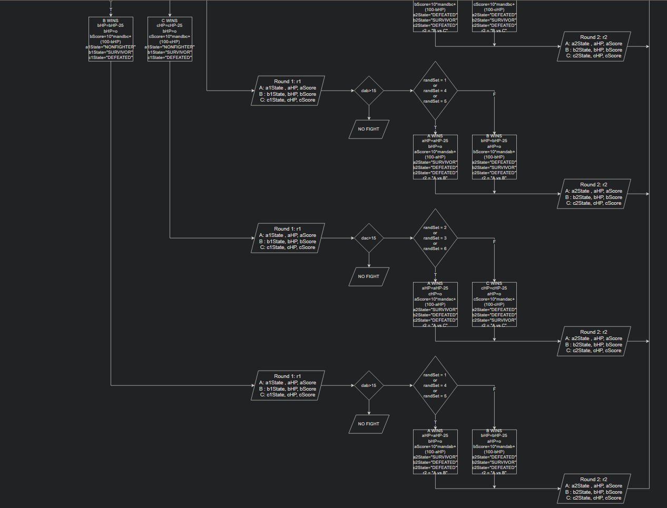
THIRD PART OF FLOWCHART

Slide 16
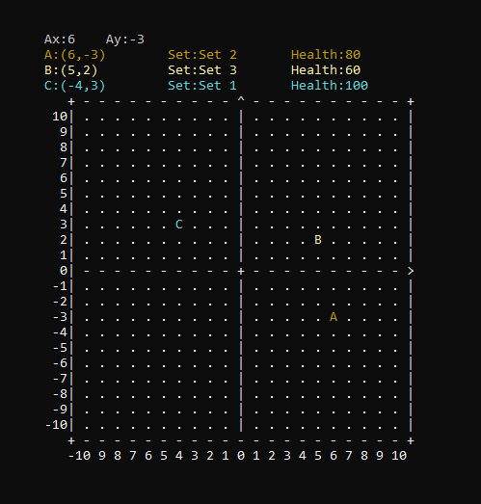
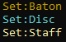
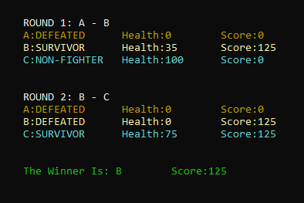
Coordinate Table Player Statements
04
SCREENSHOTS
Rounds Scores Winner

Slide 17
05
We made a game; you can play when you bored and we proud of our project.
Conclusion

Slide 18
THANK YOU FOR EVERYONE WHO LISTENED US
RESOURCES
https://tron.fandom.com/
https://dolimg.com/franchise/tron/html/codex/tron-weapons.html#

